Slide 1

Bootstrap
-By Prof Vaibhavi Patel

Slide 2
Content
Introduction to Bootstrap
Custom components: Album, Pricing, Checkout, Product, Cover, Carousel, Blog, Dashboard, Sign-in, Sticky footer.
Framework: Starter template, Grid, Jumbotron. Navbars, floating labels, Offcanvas.
BS Grid Basic, BS Typography, BS Tables, BS Images, BS List groups, BS Forms, BS Buttons, and BS button groups, Bootstrap Glyphicons Bootstarp Themes.

Slide 3
Introduction
Bootstrap is an Open-Source front-end Frame-work.
It contains HTML ,CSS and Javascript.
Bootstrap Official Address (https://getbootstrap.com/).
It is for creating responsive websites and web applications.

Slide 4
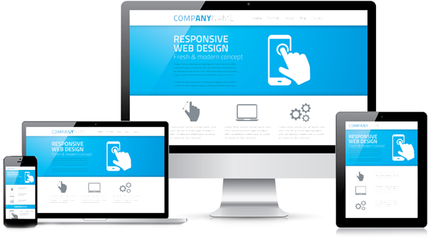
What is Responsive Design ?
The design that works properly on any resolution .

Slide 5
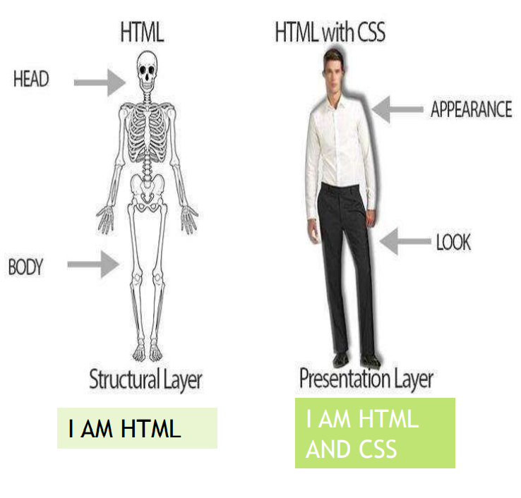
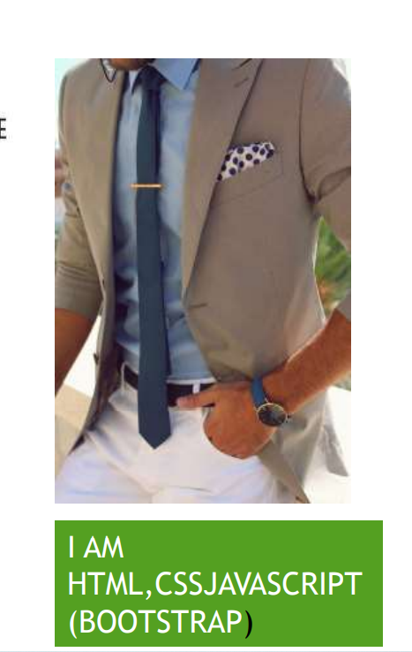
Basic difference between HTML,CSS,BOOTSTRAP

Slide 6
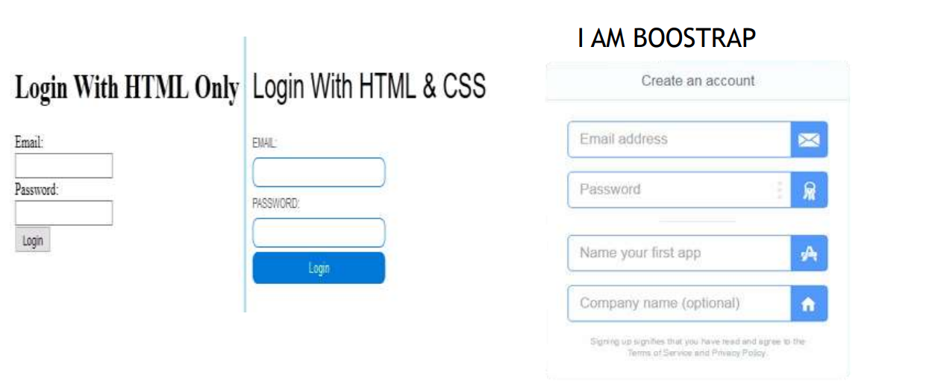
Example

Slide 7
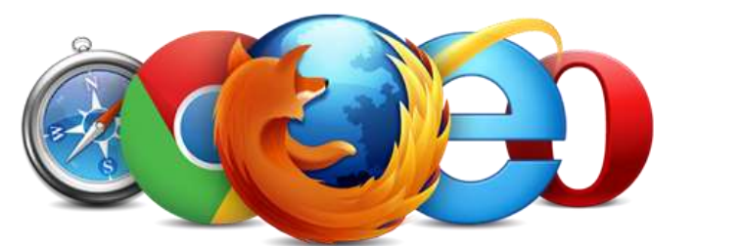
Purpose of Bootstrap
Save time
Excellent look and fell
Decrease code of line
It is easy and not complex code
It consume low space which help to execute fast in server
Browser Support: It is supported by all popular browsers.

Slide 8
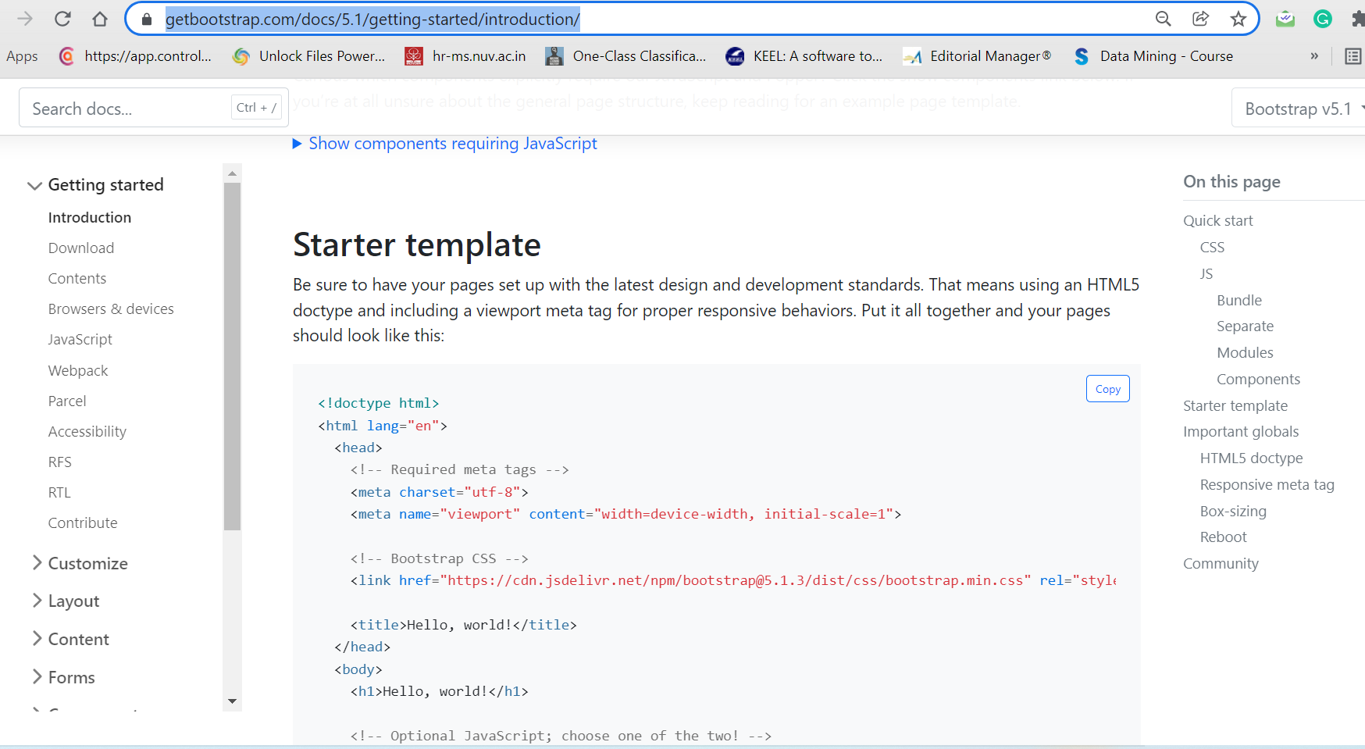
Framework- Starter template
https://getbootstrap.com/docs/5.1/getting-started/introduction/

Slide 9
Framework- Grid
Grid systems are used for creating page layouts through a series of rows and columns that house your content.
Bootstrap includes a responsive, mobile first fluid grid system that appropriately scales up to 12 columns as the device or viewport size increases. It includes predefined classes for easy layout options.
for more (https://getbootstrap.com/docs/5.0/layout/grid/ )

Slide 10
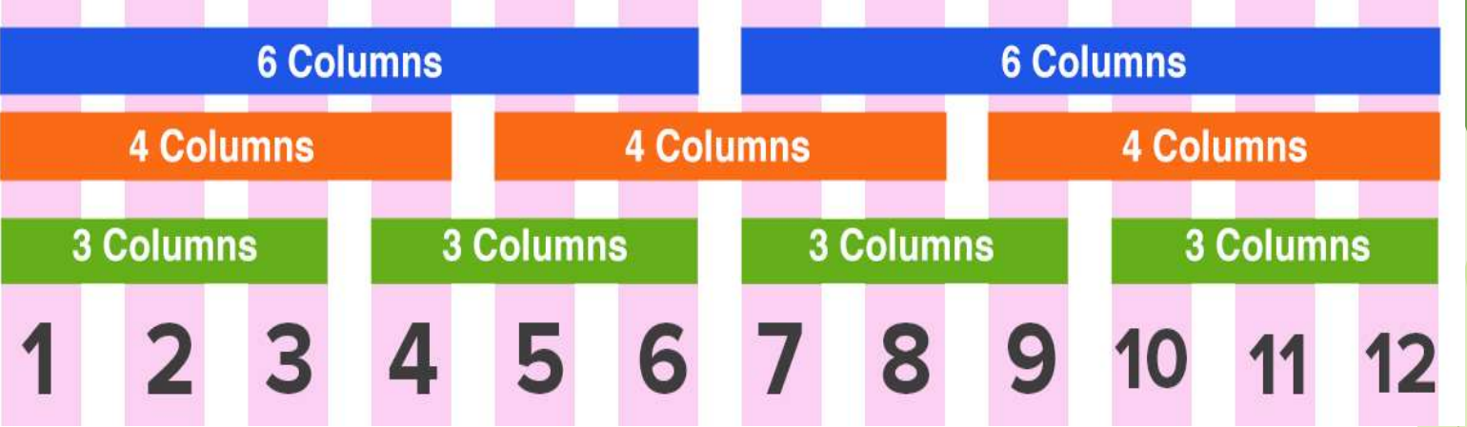
Bootstrap Grid System Example

Slide 11
Framework- Jumbotron
A jumbotron indicates a big grey box for calling extra attention to some special content or information.
https://getbootstrap.com/docs/5.1/examples/jumbotron/
Notes:
Used when you want big intro may be on blog post where the first paragraph to be kind of bold and in your face containing what that blog about.
Something which you want to highlight.

Slide 12
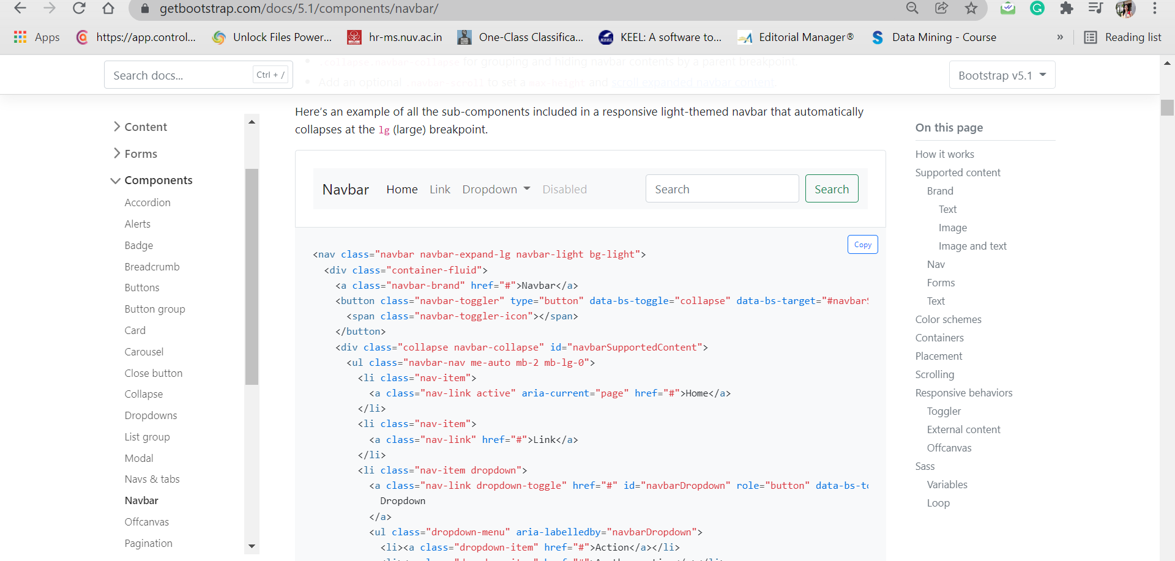
Framework- Navbars
https://getbootstrap.com/docs/5.1/components/navbar/

Slide 13
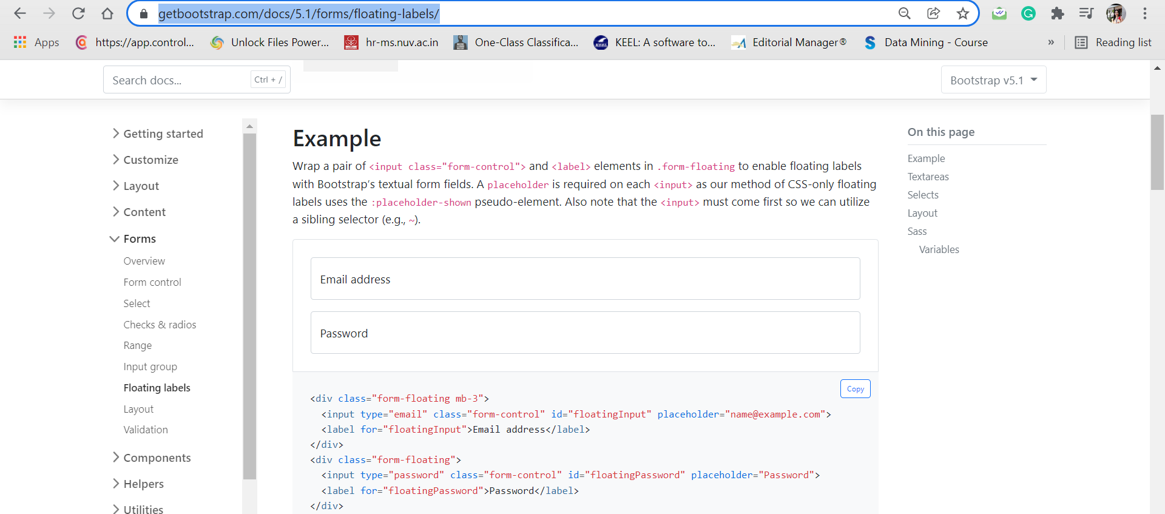
Framework- floating labels
You can create beautifully simple form labels that float over your input fields.
https://getbootstrap.com/docs/5.1/forms/floating-labels/

Slide 14
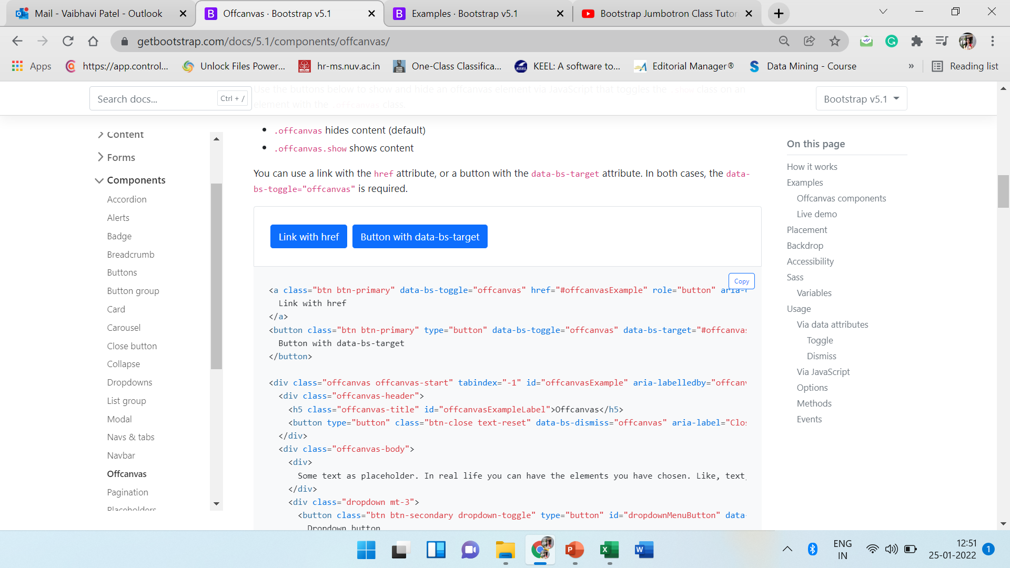
Framework- Offcanvas
You can build hidden sidebars into your project for navigation, shopping carts, and more with a few classes and our JavaScript plugin.
https://getbootstrap.com/docs/5.1/components/offcanvas/

Slide 15
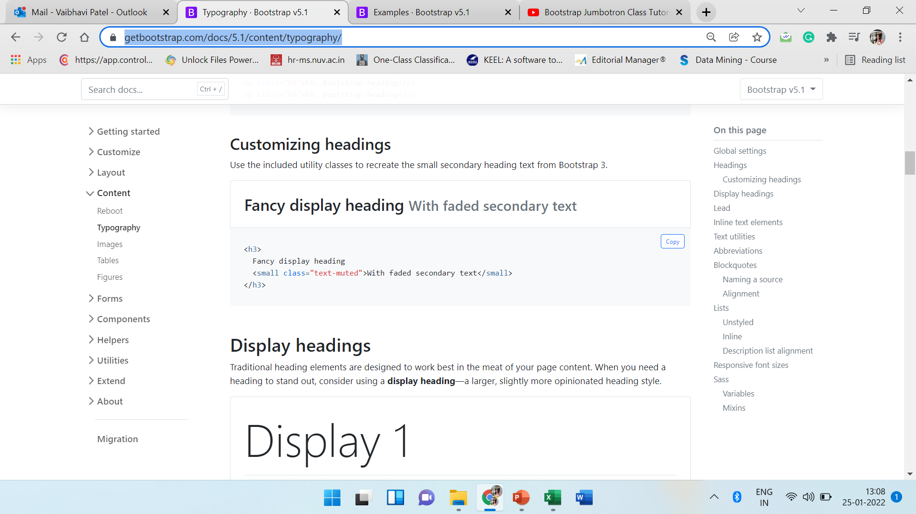
BS Typography
https://getbootstrap.com/docs/5.1/content/typography/

Slide 16
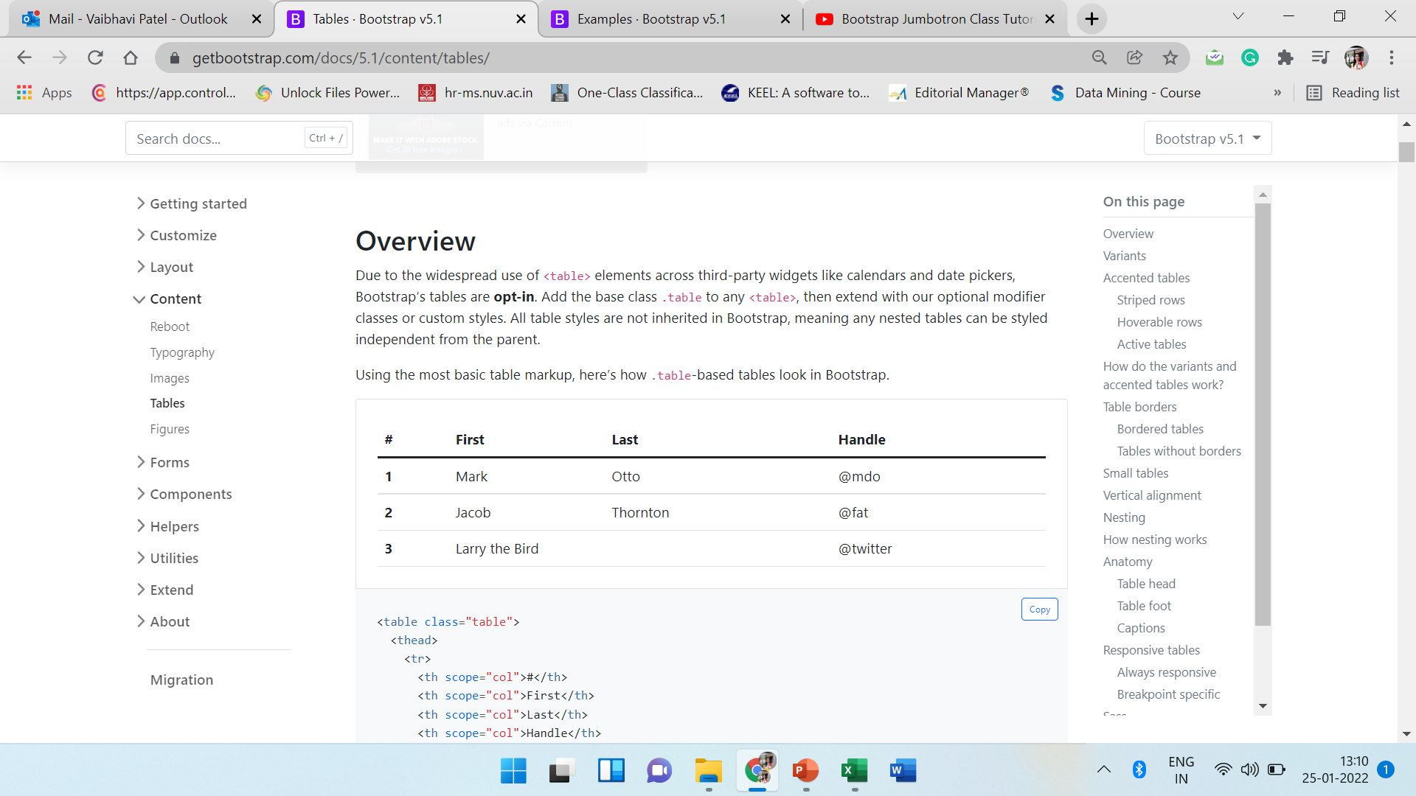
BS Tables
https://getbootstrap.com/docs/5.1/content/tables/

Slide 17
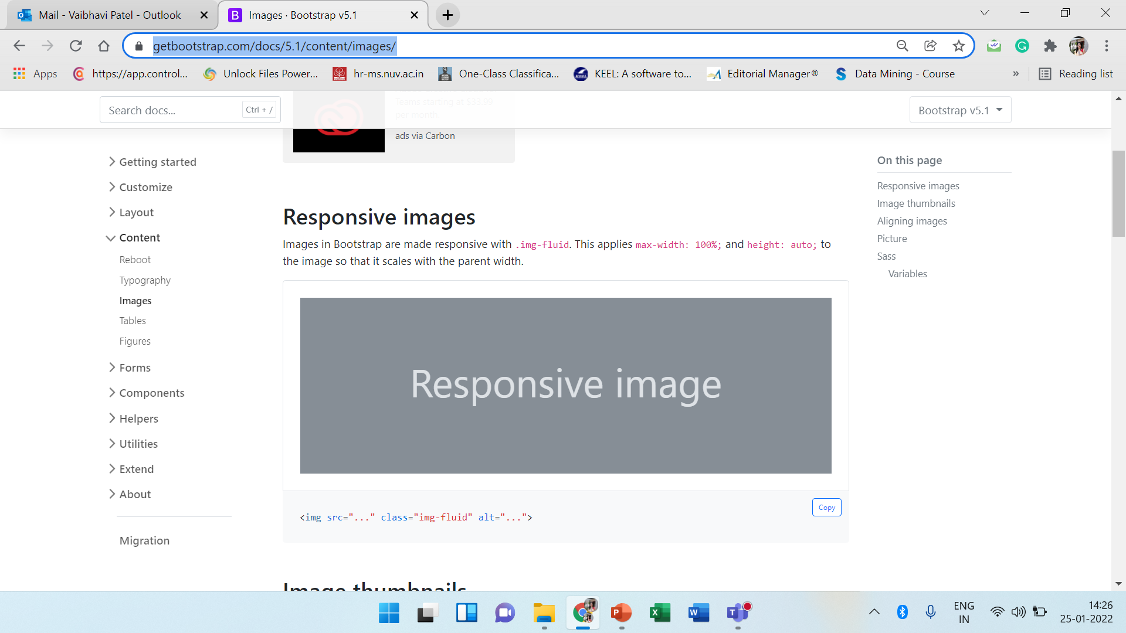
BS Images
https://getbootstrap.com/docs/5.1/content/images/

Slide 18
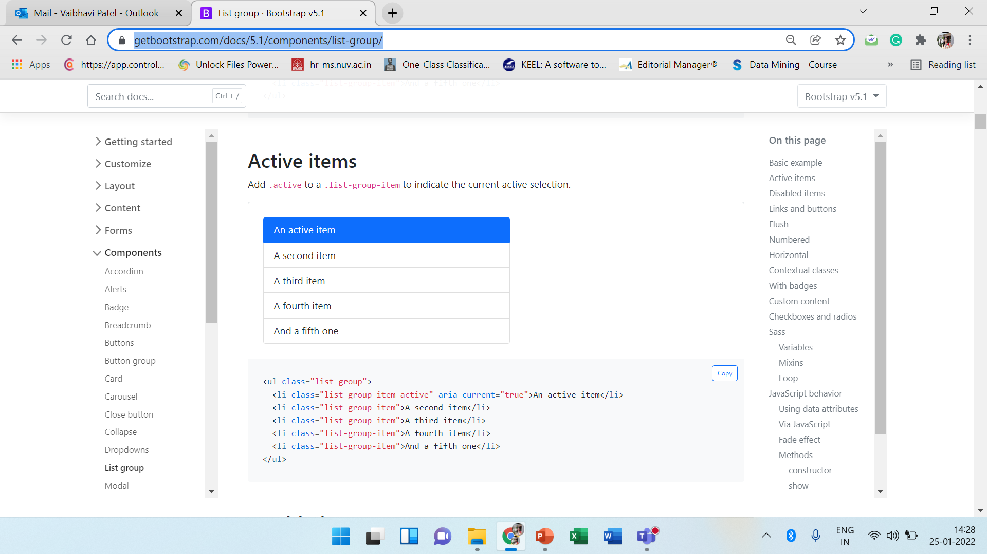
BS List groups
https://getbootstrap.com/docs/5.1/components/list-group/

Slide 19
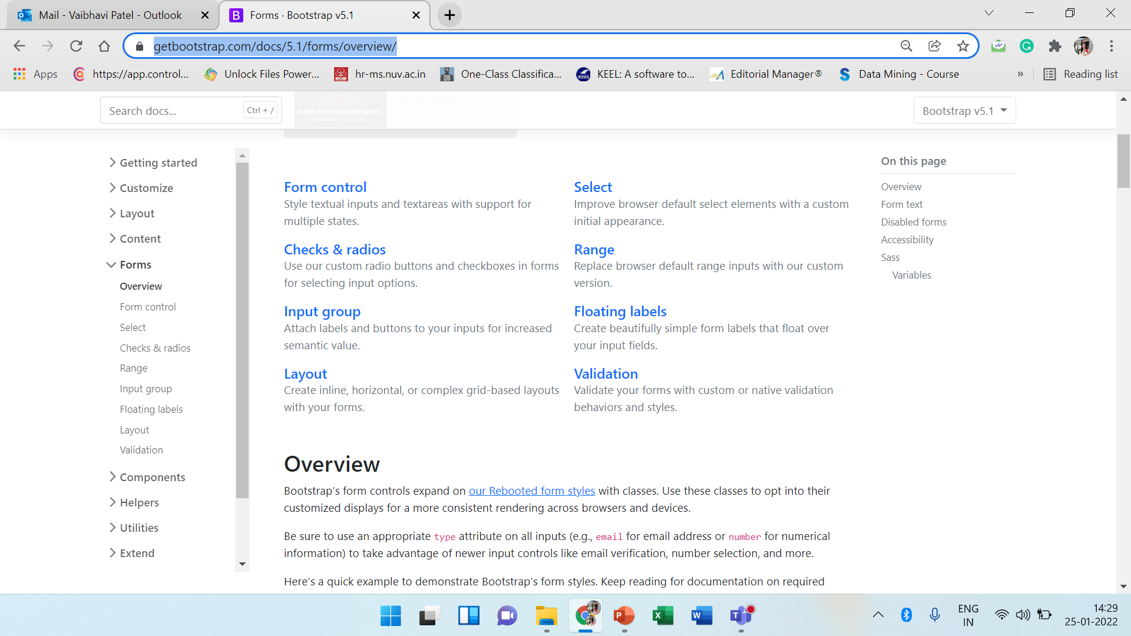
BS Forms
https://getbootstrap.com/docs/5.1/forms/overview/

Slide 20
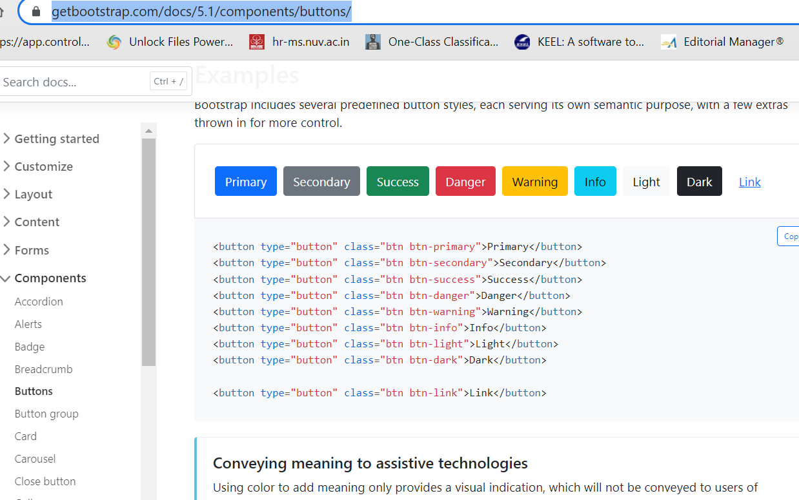
BS Buttons
https://getbootstrap.com/docs/5.1/components/buttons/

Slide 21
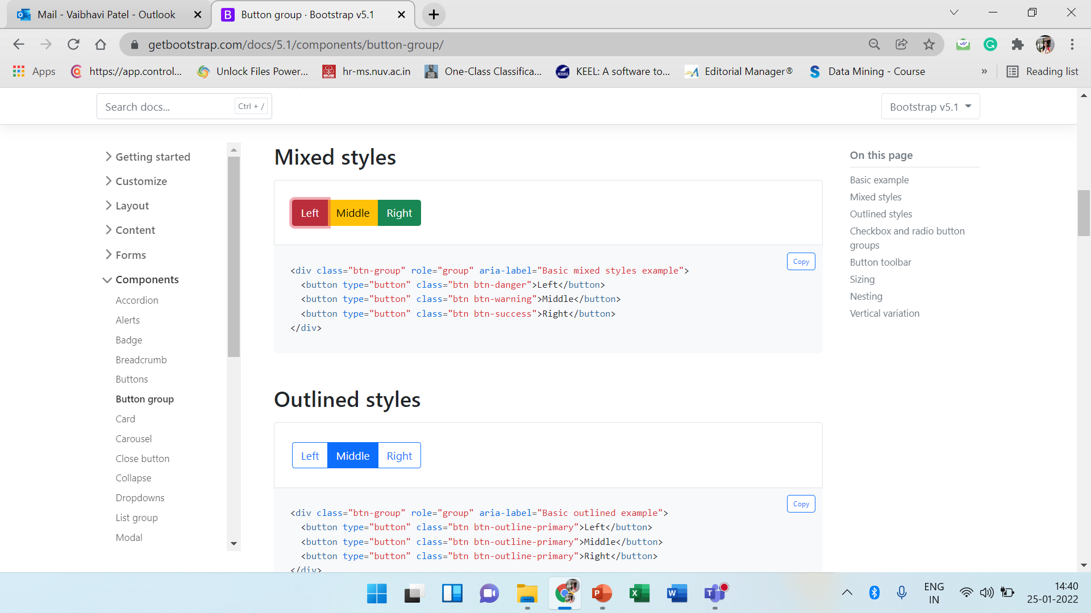
BS Button group
https://getbootstrap.com/docs/5.1/components/button-group/

Slide 22
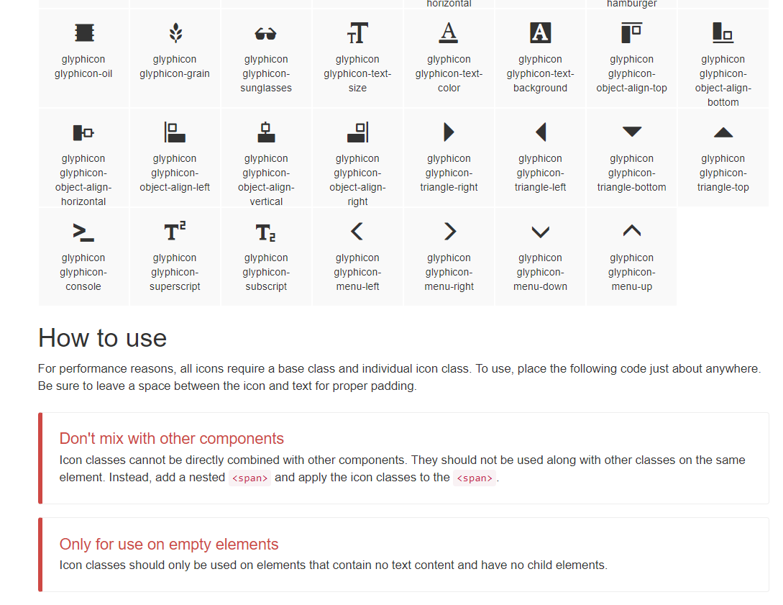
BS Glyphicon
https://getbootstrap.com/docs/3.4/components/#glyphicons

Slide 23
BS Themes
https://themes.getbootstrap.com/
https://www.w3schools.com/bootstrap/bootstrap_templates.asp

Slide 24
Spacing in bootstrap
Bootstrap includes a wide range of shorthand responsive margin utility classes to modify an element’s appearance.
Where property is one of:
m - for classes that set margin
p - for classes that set padding
Where sides is one of:
t - margin-top , b - margin-bottom , s - margin-start , e - margin-end, x - both *-start and *-end , y - set both *-top and *-bottom
Value can be from 0 to 5 or auto (Horizontal centering)
For example mx-auto , my-5

Slide 25
Custom components
Album: https://getbootstrap.com/docs/5.1/examples/album/
Pricing: https://getbootstrap.com/docs/5.1/examples/pricing/
Checkout: https://getbootstrap.com/docs/5.1/examples/checkout/
Product: https://getbootstrap.com/docs/5.1/examples/product/
Cover: https://getbootstrap.com/docs/5.1/examples/cover/
Carousel: https://getbootstrap.com/docs/5.1/examples/carousel/
Blog: https://getbootstrap.com/docs/5.1/examples/blog/
Dashboard: https://getbootstrap.com/docs/5.1/examples/dashboard/
Sign-in: https://getbootstrap.com/docs/5.1/examples/sign-in/
Sticky footer: https://getbootstrap.com/docs/5.1/examples/sticky-footer/

Slide 26
Thank You

